Slide 1

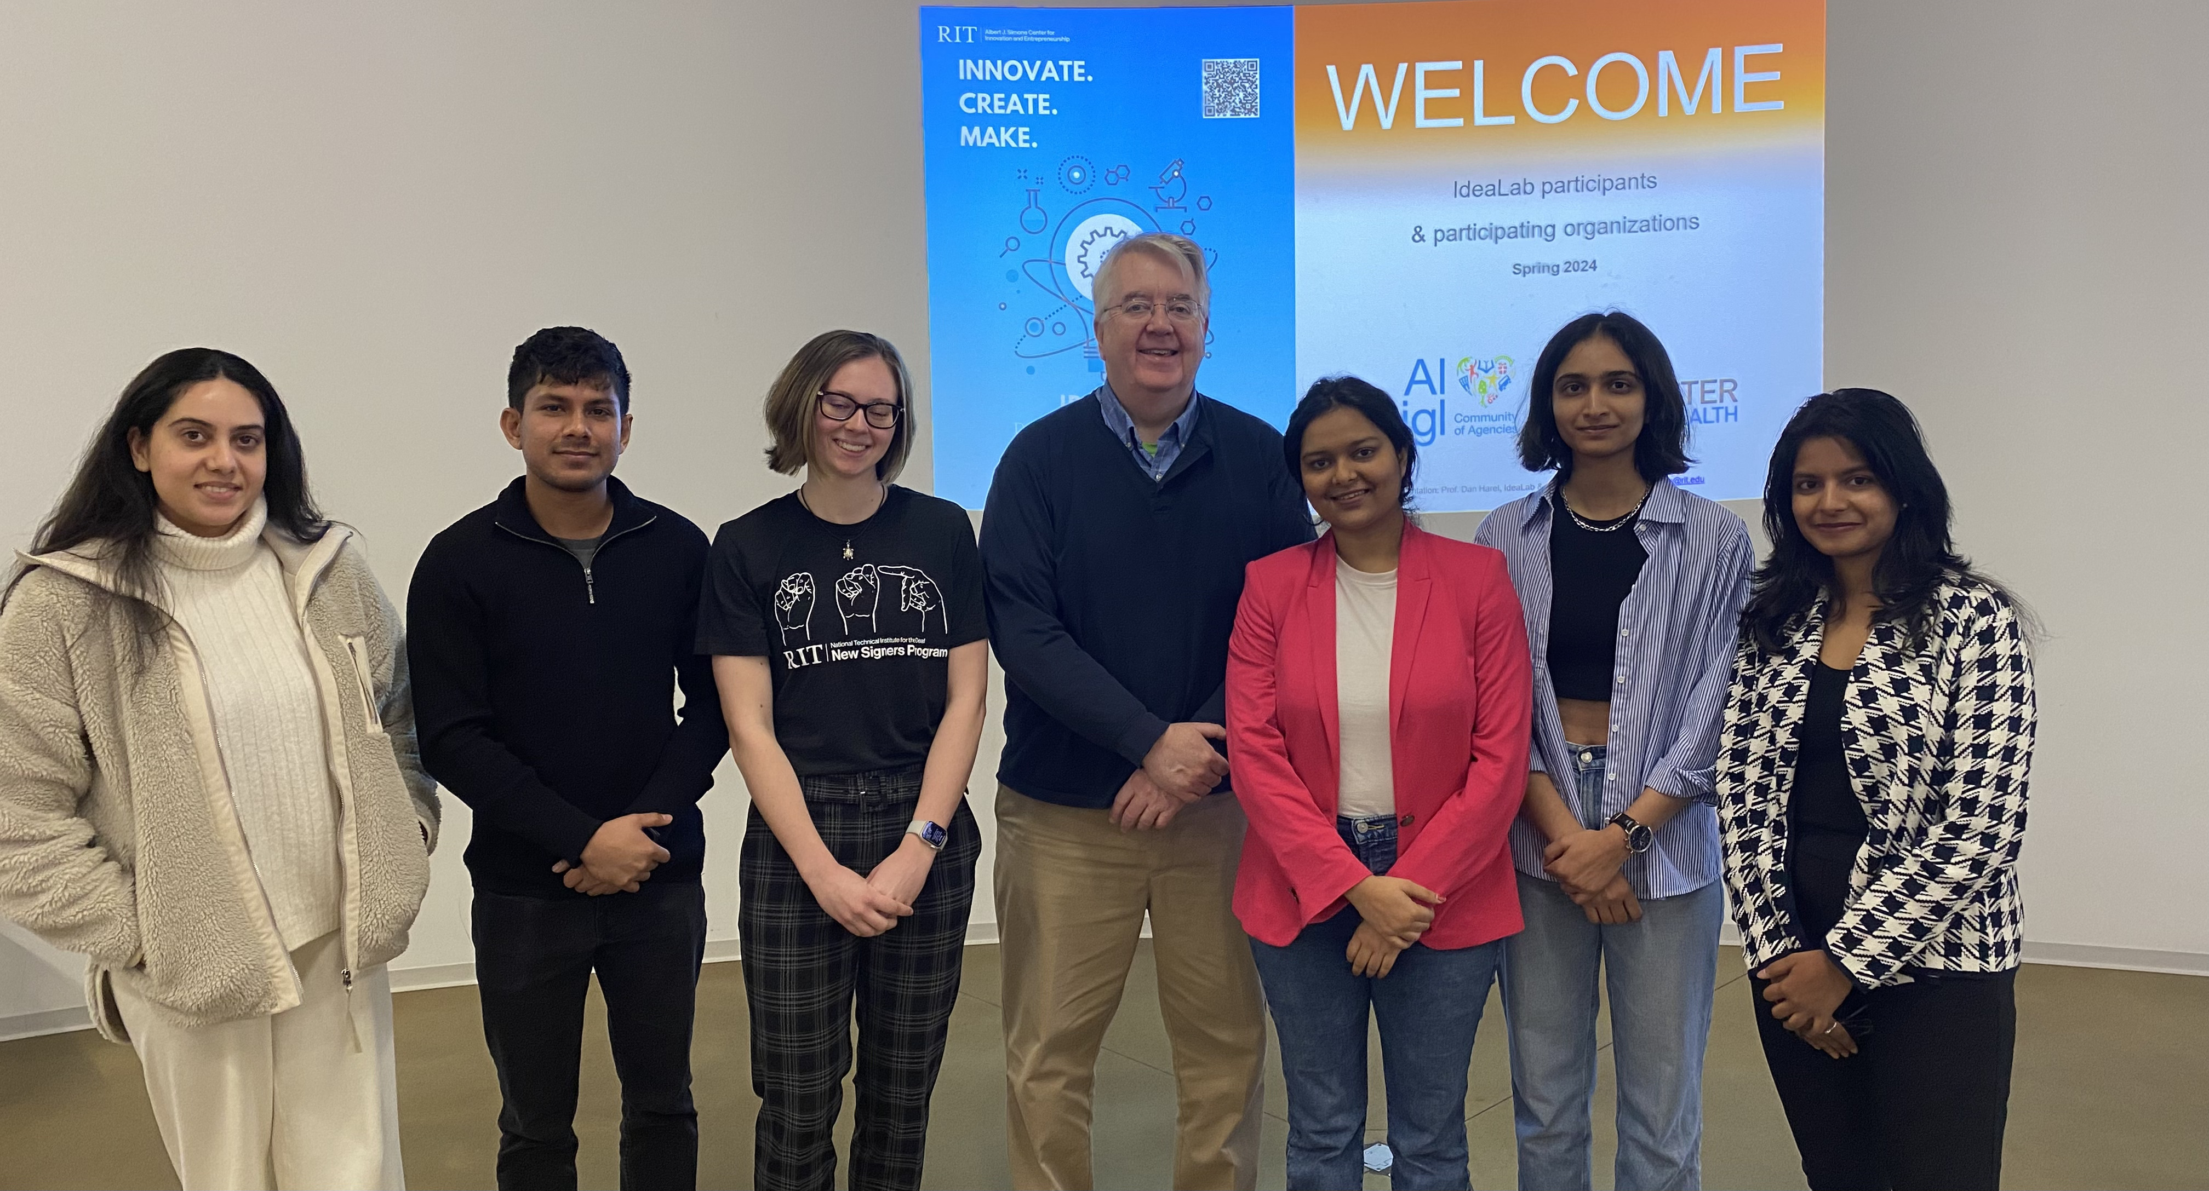
Patients walking away
from their assistive devices
Spring 2024
Team members contact information
Name College/Department -Year Email Contact
Tejaswini Vantigodi GCCIS-MS HCI-2nd year tv8913 585-481-9173
Anoushka Puranik GCCIS-MS HCI-2nd year ap3988 585-471-9228
Megan Wilson SCB-UG ACCT-1st year mdw7667 814-880-5442
Jyothi Bhavani Bachu SCB-MBA- 2nd year jb1542 585-604-9549
Ankita Sindhu SCB-MSBA-2nd year as5767 585-309-6762
Robin Miranda KGCOE-ME-ME-2nd year rm2688 585-6061753
Team Advisor (Client)
Name: Colleen Zuniga Email: czquigley@gmail.com Contact: 5853292018
Team Coach (RIT Faculty)
Name: James Ramsey

Slide 2
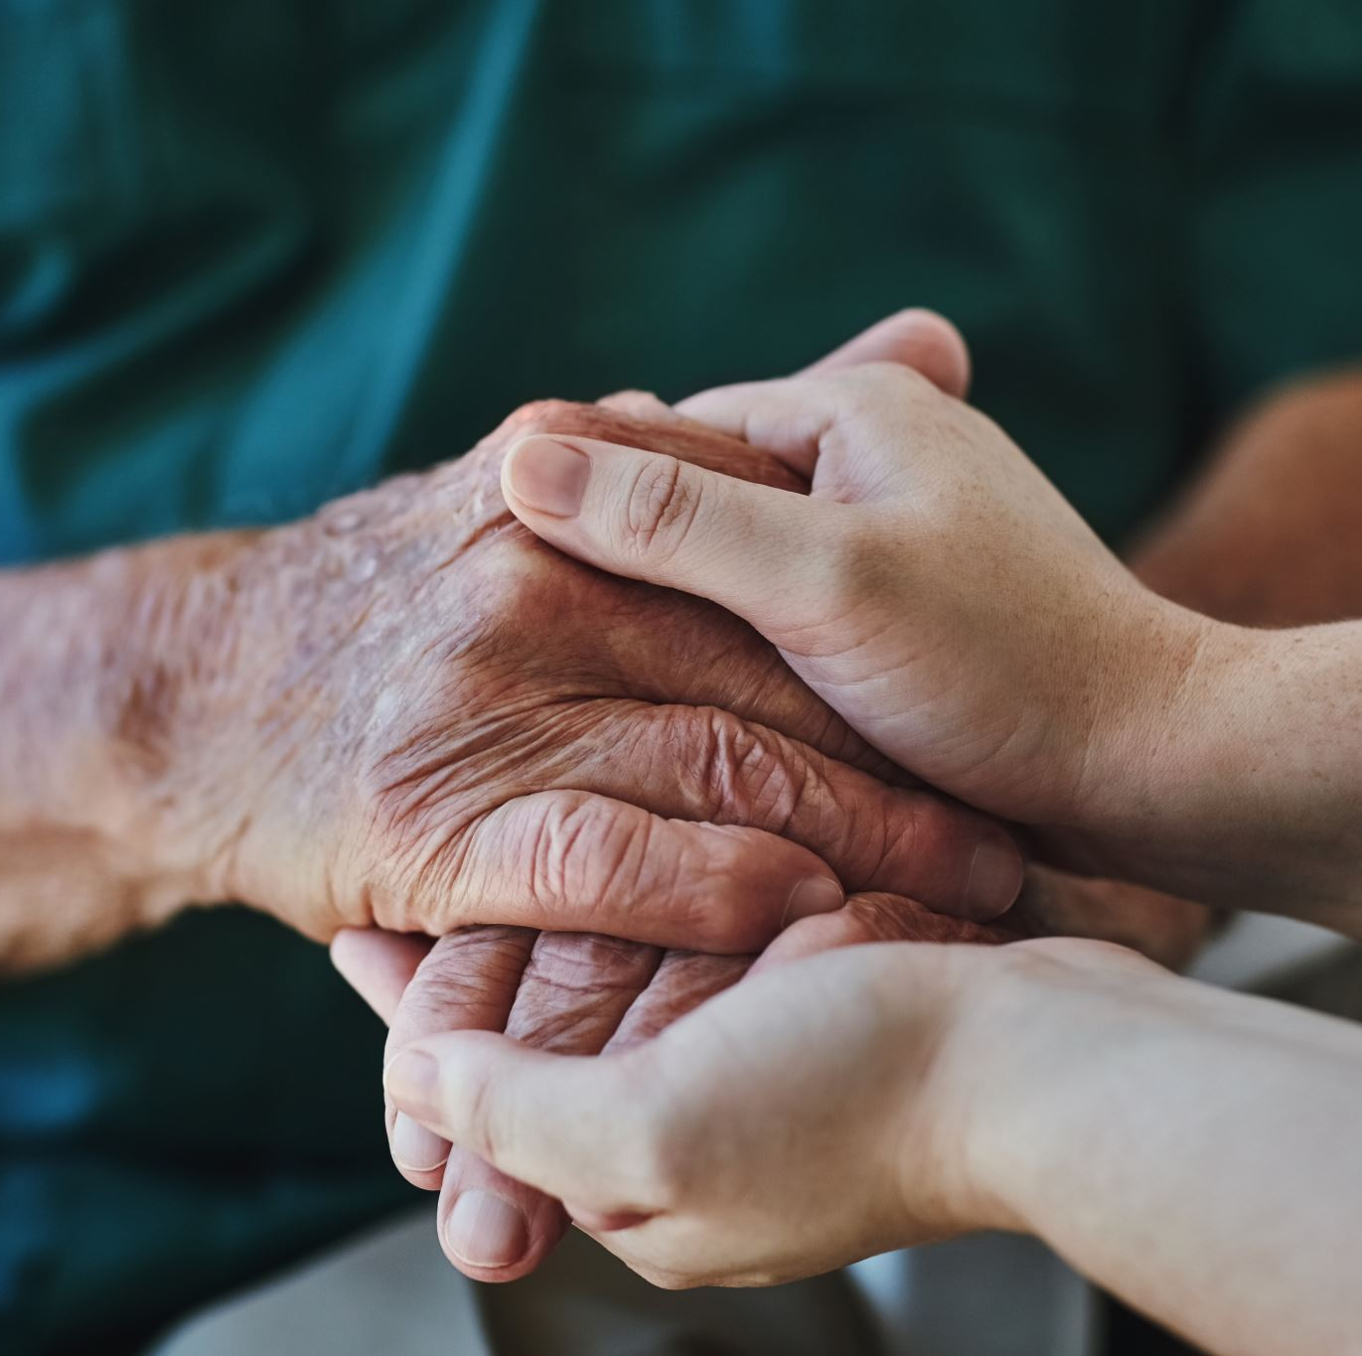
Original problem description
Patients walking away from their Assistive Devices :
Older people often forgetfully walk away from their cane walker without realizing; which is a major safety issue. As there is a high chance certain times, they fall out, which leads to major accidents.

Slide 3
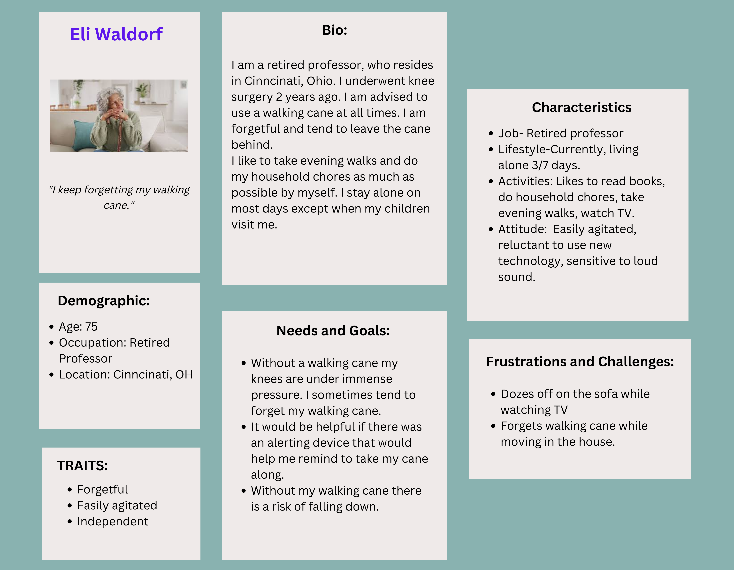
Persona
3

Slide 4
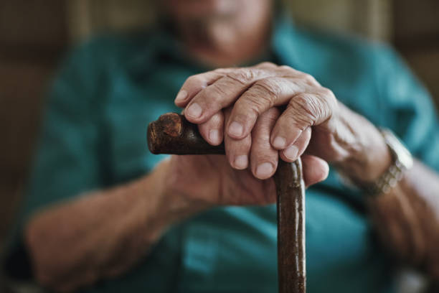
Context
Elderly often forget to carry their walking canes or other assistive devices with them.
They need an alerting system that will remind them to take their assistive devices along.
This alerting system must be ambient with little to no sound, and subtle haptic vibrations.

Slide 5

Refined problem definition
Context: The problem exist in people 58 years old and above. May have other health conditions that have negative effects on their daily lives
Problem: When these people step away from their assistive devices it can increase the chances of them falling and having major accidents.
Solution: Device that can remind patients of their assistive device while also being comfortable, multifunctional, and always on them.

Slide 6
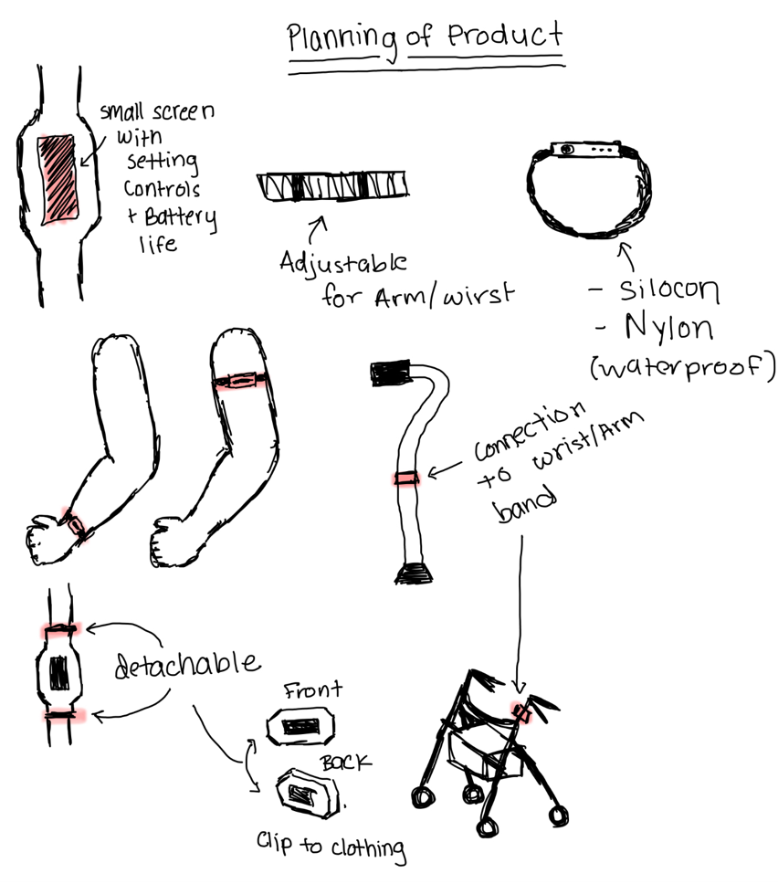
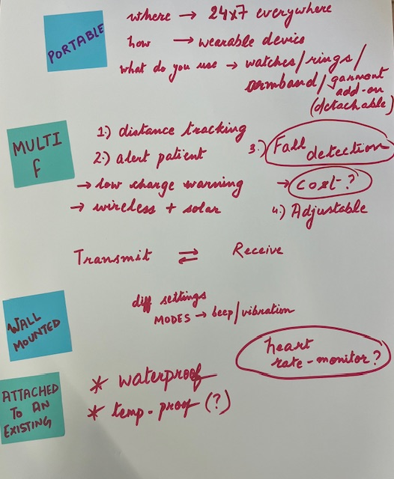
Design Process
Beginning section our brainstorming into section based on workshop
We found if the device is annoying people are less likely to wear it
comfort fitting
keeping in mind sensitivity

Slide 7
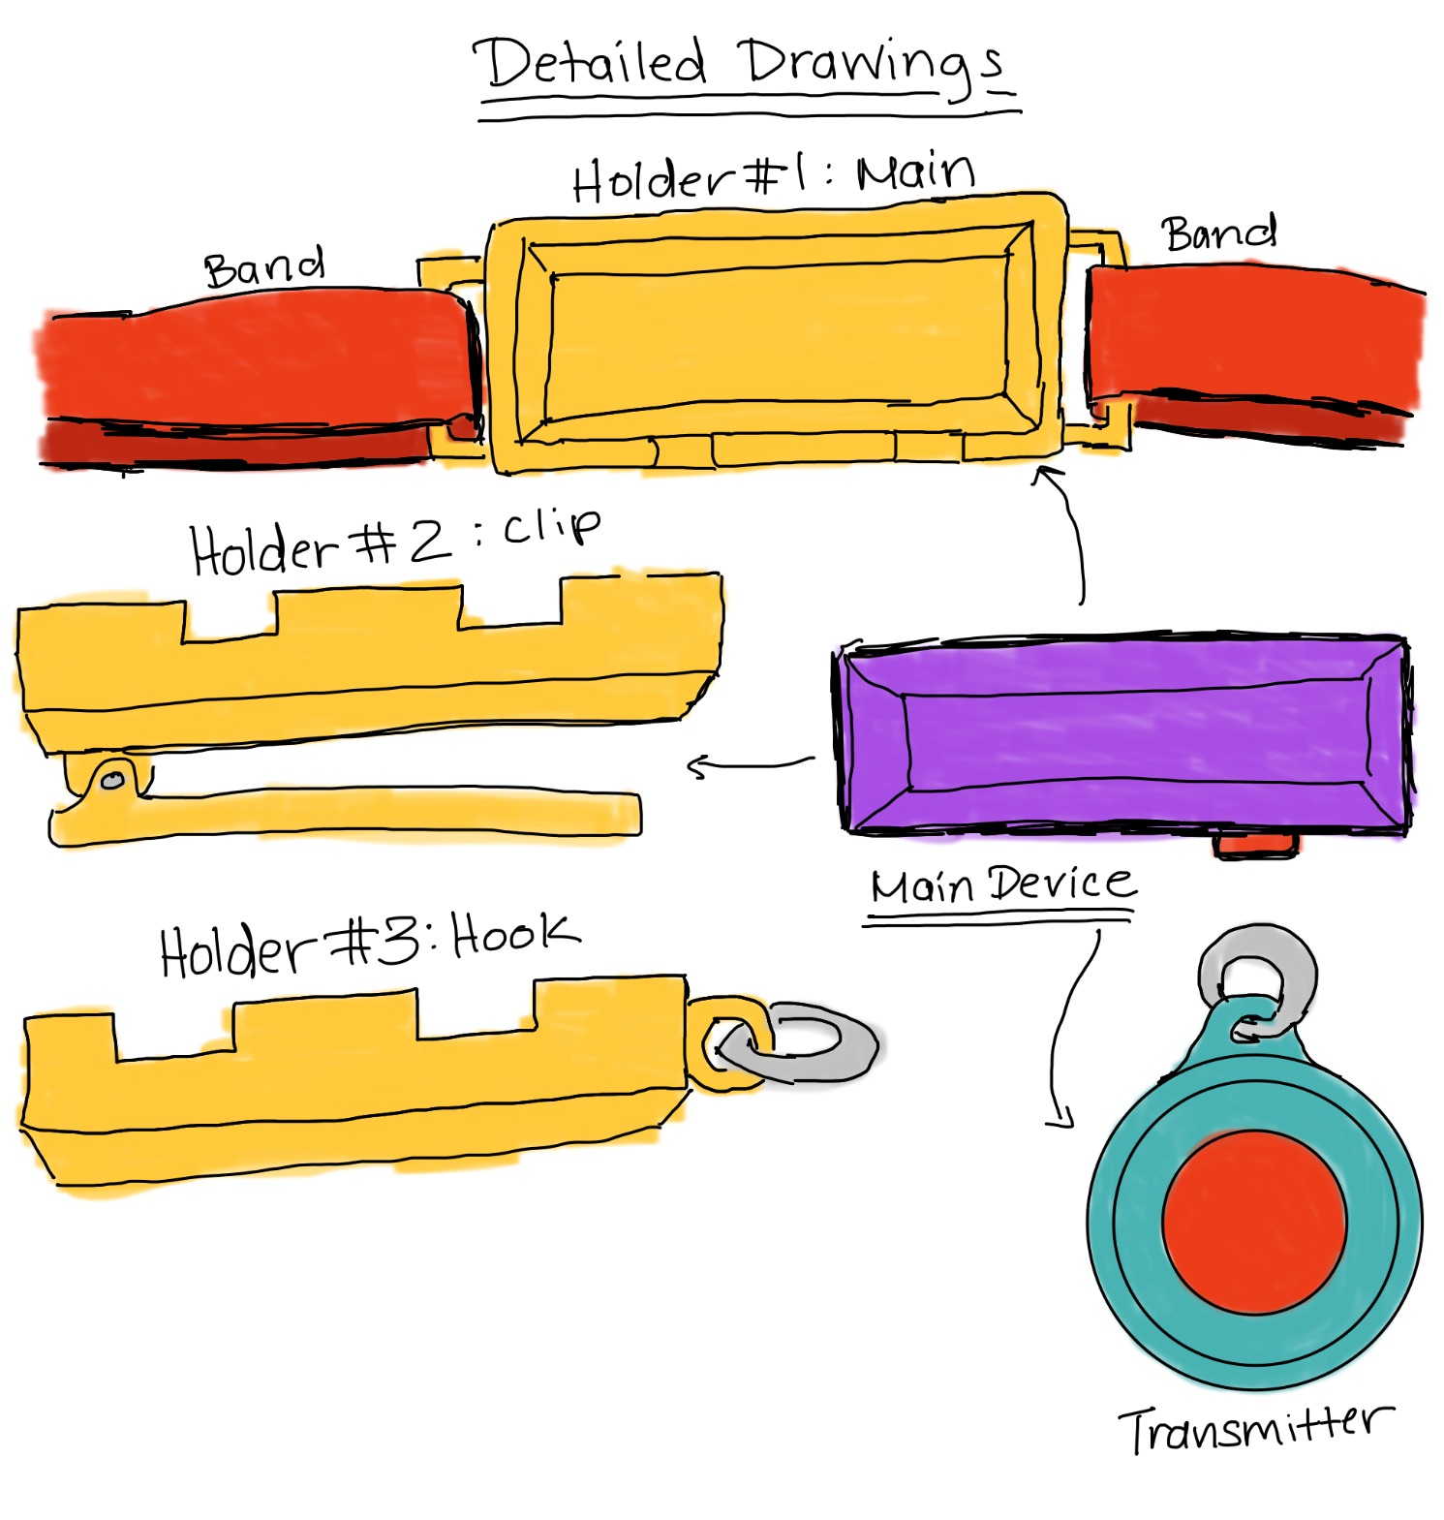
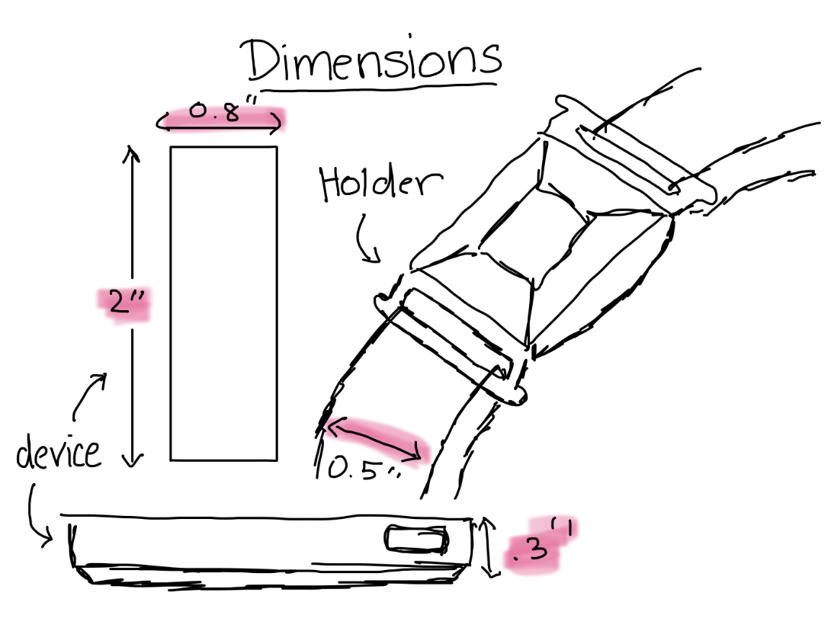
Final concept solution sketches

Slide 8
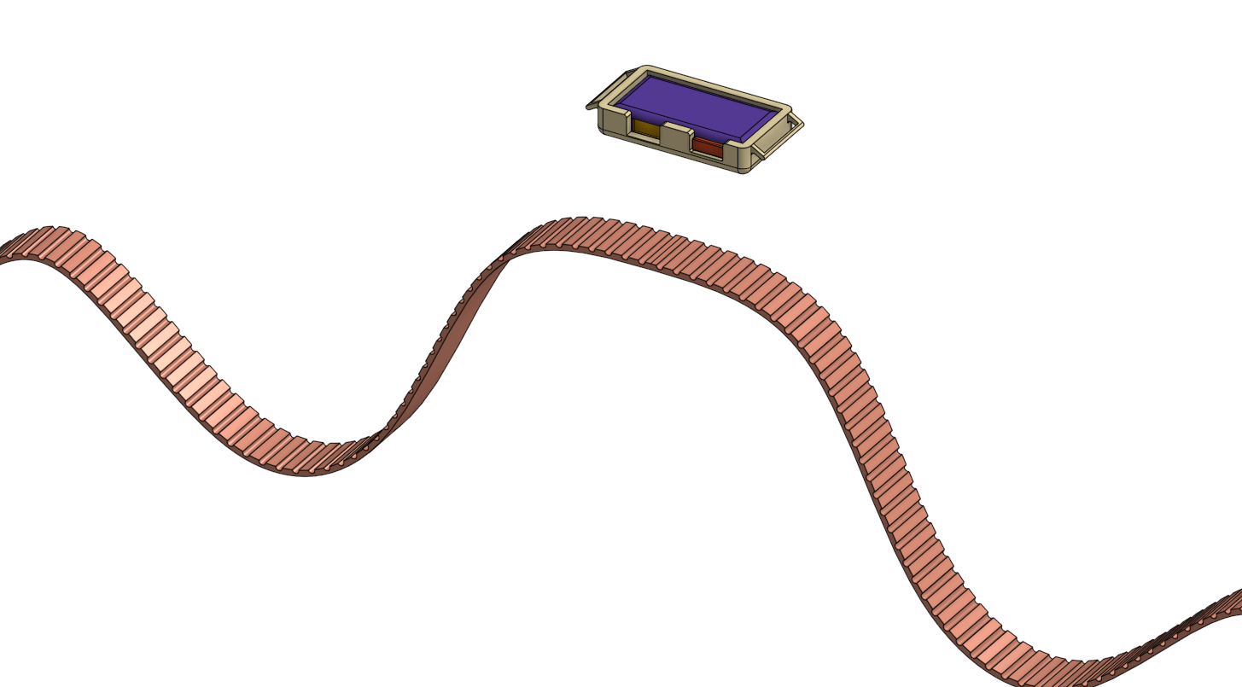
CareConnect
Main device
Arm/Wrist Bracket
Made up of high-quality plastic. Durable hard shell. Plastic keeps it light weight and cost effective.
Nylon
Arm/Wrist Strap
Double-layered nylon weave, has dense loops on the skin side that provides soft cushioning while allowing moisture to escape. It features a hook-and-loop Velcro fastener for quick and easy adjustment.
Soft
Breathable
Lightweight
Waterproof

Slide 9
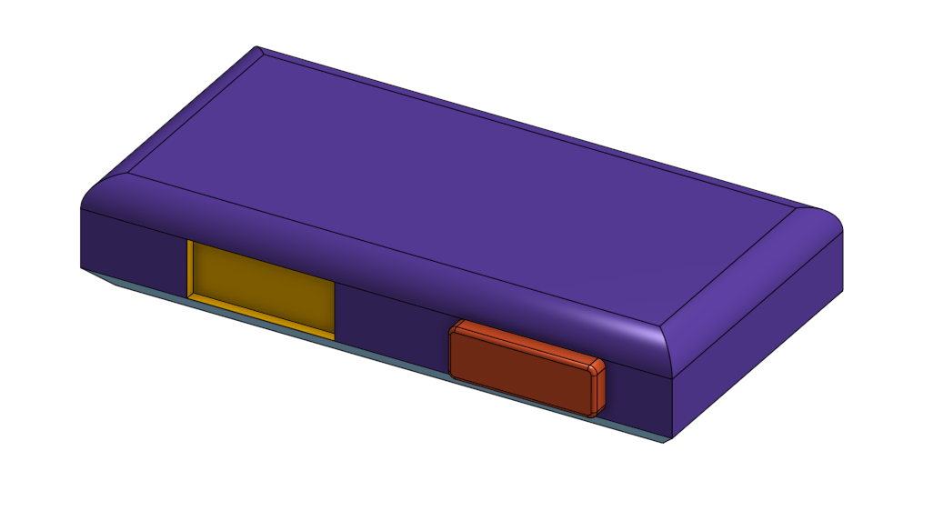
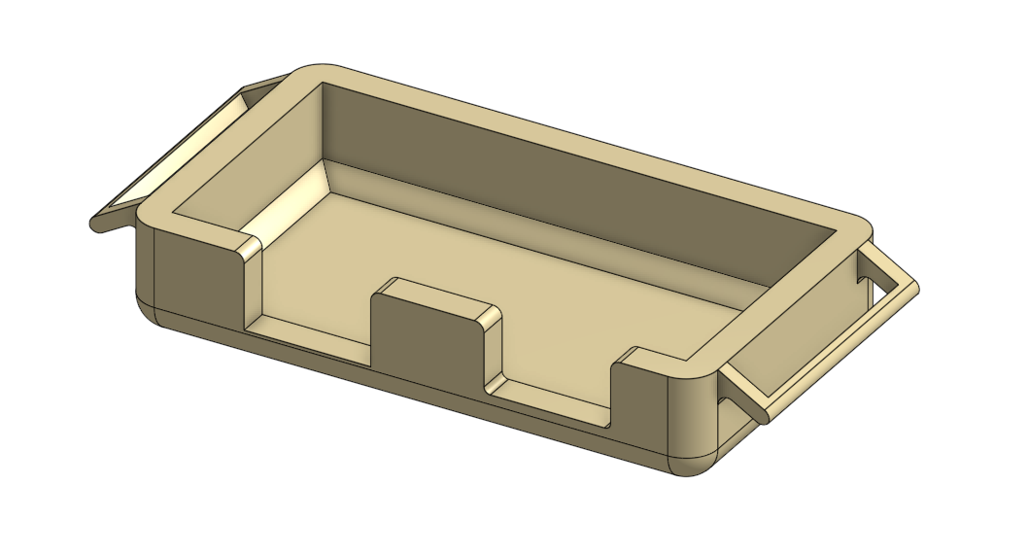
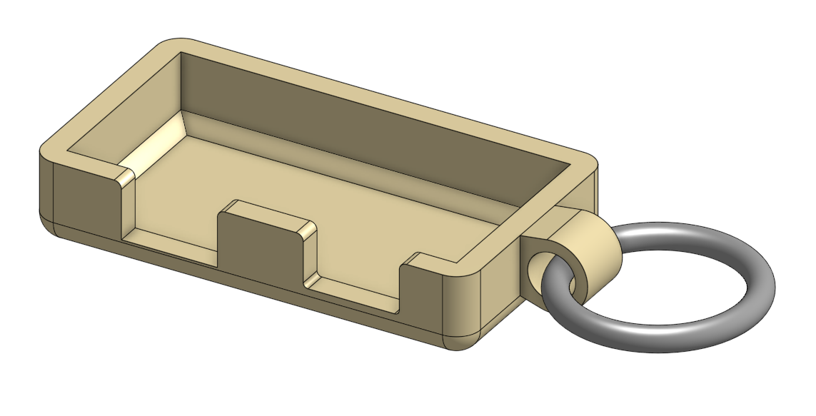
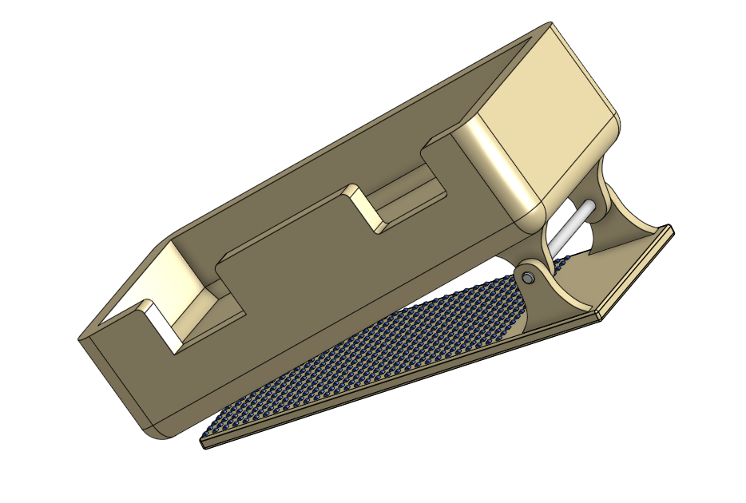
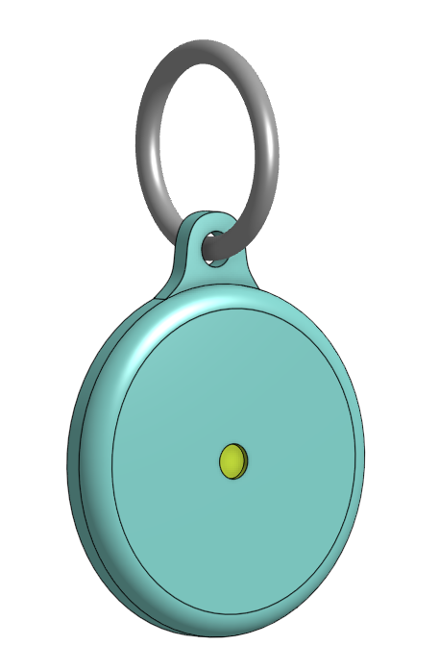
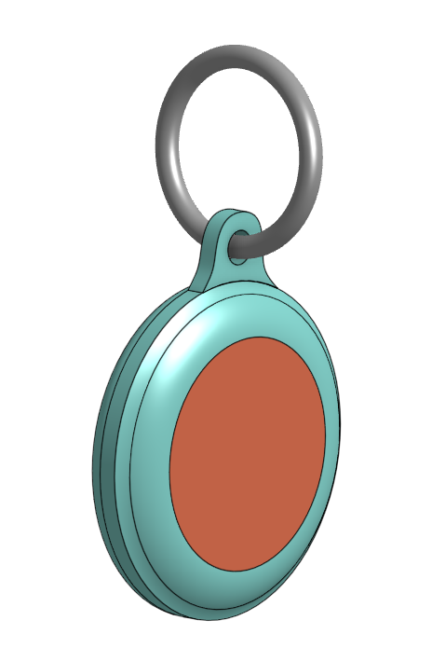
Experimental 3D prototypes
Main device
Carabiner hook
Hook bracket
Power on/off switch
Arm/wrist bracket
LED indicator
Spring loaded clip/hinge
Clip bracket
Textured grip
Transmitter
3M Double sided VHB tape

Slide 10
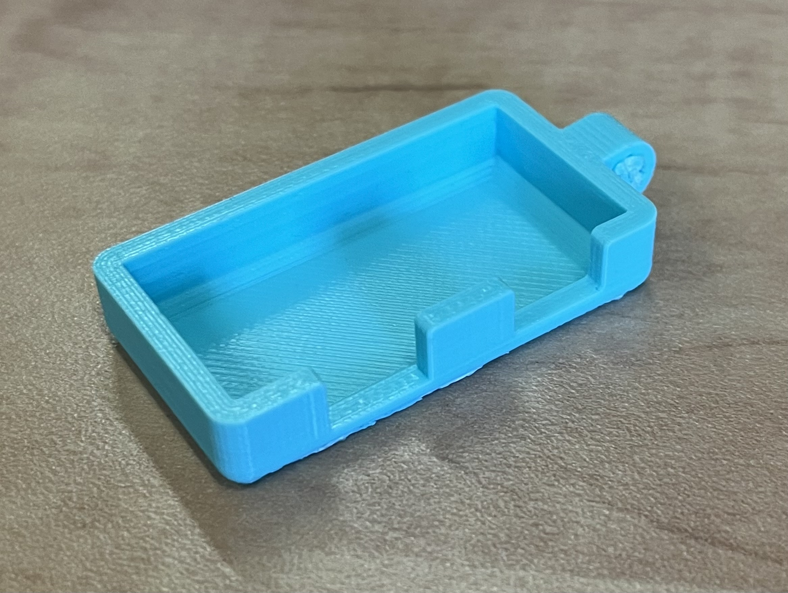
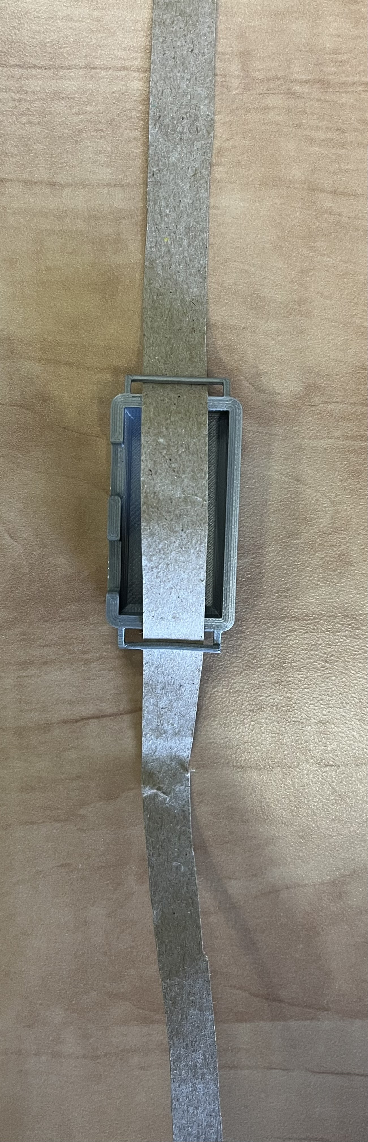
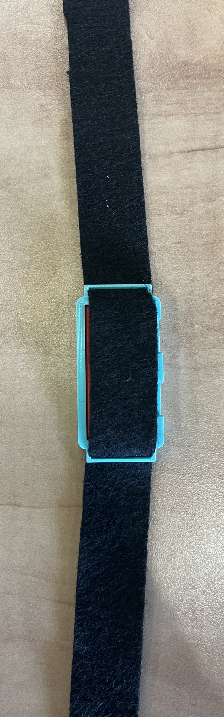
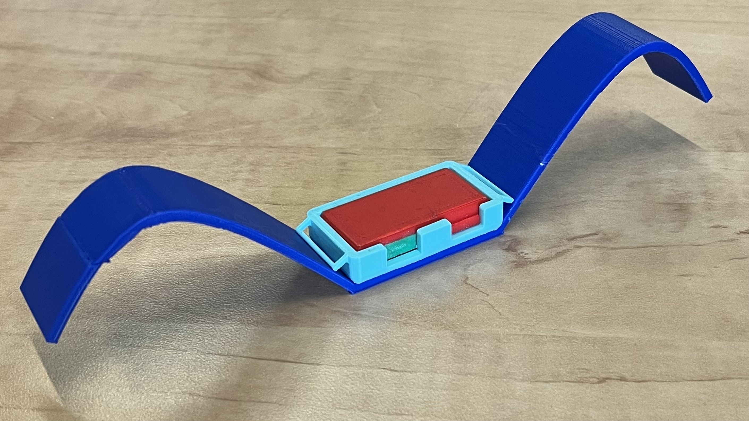
Printed Designs

Slide 11
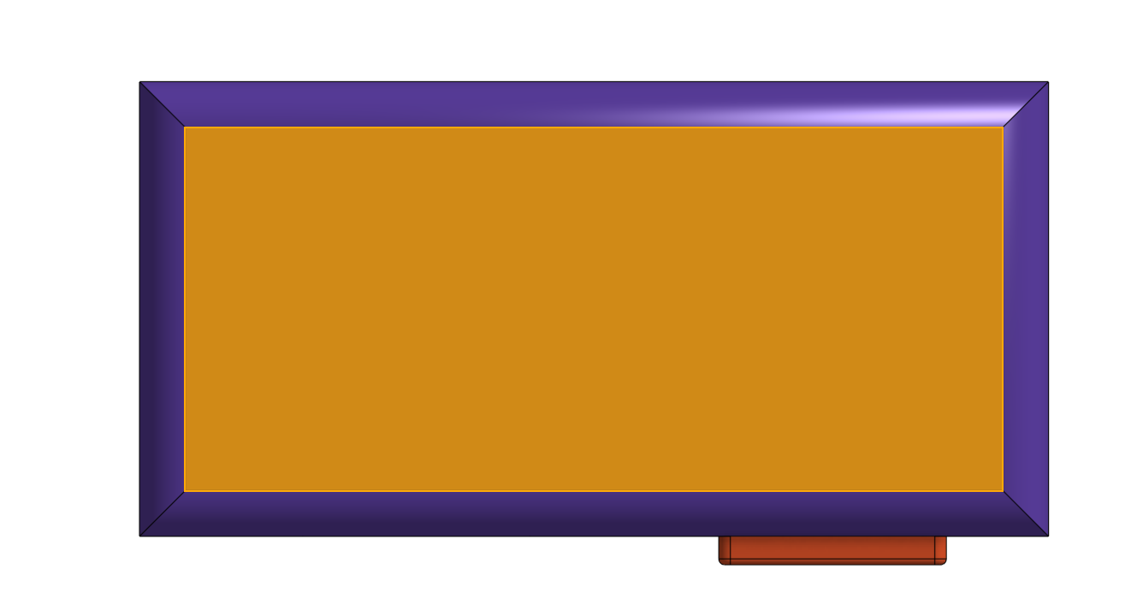

Internal Tech
Linear Resonant
125 Hz f
2.5 V DC
Gold contactors
Micro
Read/Write
13.56 MHz
RFID
Sensor module
Haptic vibrator
Piezo electric
Buzzer
Battery (450 mAh)
A
LED
Motherboard
Strip
Accelerometer

Slide 12
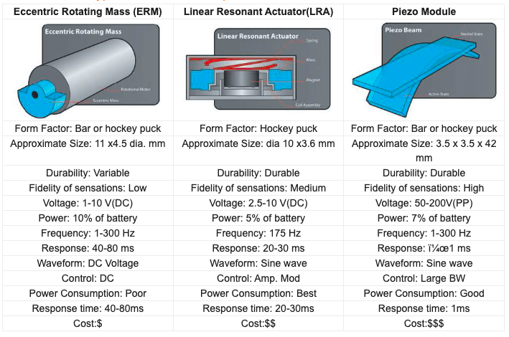
Specifications for Haptic vibrator

Slide 13
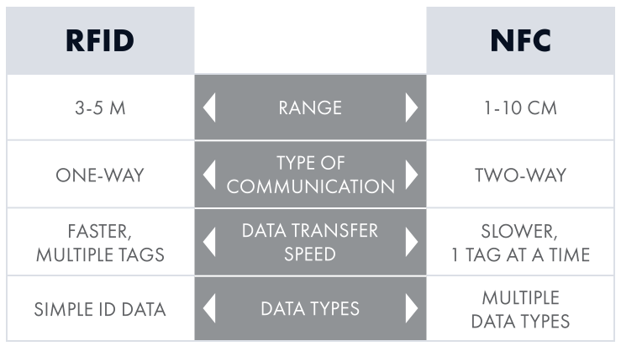
RFID vs NFC

Slide 14


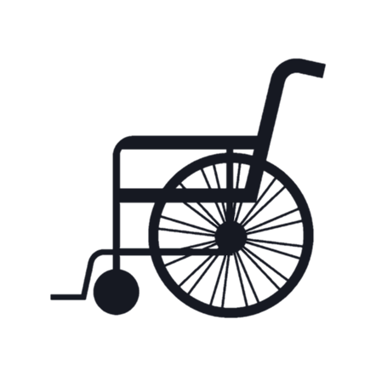
RFID Sensor Range
3 ft radius – does not trigger anything
> 3 ft radius
light haptic taps,
1 tap/sec
> 6ft radius
starts beeping,
haptic turned to level max level set by the user/ caregiver,
caregiver/ hospital staff notified
14

Slide 15
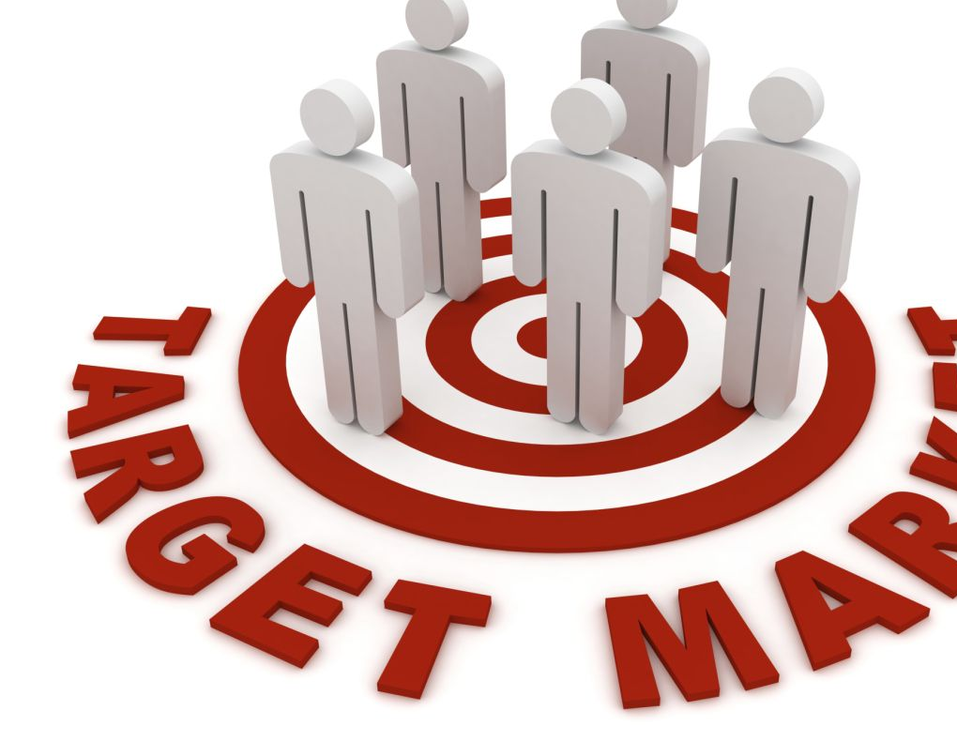
Target market/Business viability
Market Characteristics:
Age Group: Primarily targeting individuals aged 58 and above.
Health Conditions: Those with conditions like dementia, mobility challenges, or other impairments.
Caregivers: Family members, healthcare providers, or assisted living facilities looking for solutions to enhance patient safety

Slide 16
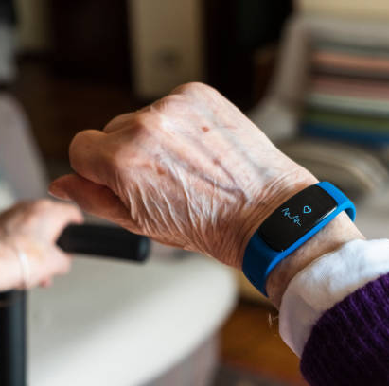
Business Model
The business model for the hand band can be explored in both B2C and B2B markets.
B2C (Business-to-Consumer):
Online Sales: Utilize e-commerce platforms to directly reach end-users and caregivers.
Retail Partnerships: Collaborate with retailers specializing in medical equipment or aging care products.
B2B (Business-to-Business):
Healthcare Institutions: Partner with hospitals, clinics, and assisted living facilities to provide the hand bands as part of patient care and safety.
Distribution to Retailers: Establish relationships with distributors who cater to healthcare and senior care products.

Slide 17
Stakeholders
Caregivers
The fall detection feature can help caregivers to get notified when their loved ones have had a fall and need assistance.
Elderly person
This alert system can remind the elderly if they have forgotten their walking canes or other assistive devices behind.
Manufacturers
Manufacturers can integrate this alerting device in their products like wheelchairs, walking canes, hearing aids, etc.
17

Slide 18
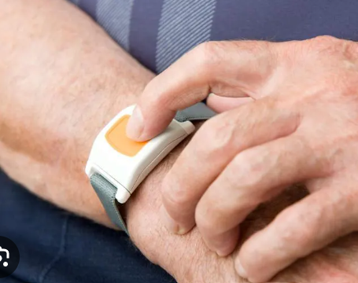
Competitive Benchmarking
We have evaluated product on the following ways :
Effectiveness: Evaluation of the reliability of alerts and notifications provided by the product.
Ease of understanding and usage, especially for seniors. product's interface and setup process are easy- User-Friendly
Inspection of the comfort level for prolonged use.
Assessment of any interference with the wearer's daily activities.
Affordability: provides value for money.

Slide 19
Comparing 3-4 existing solutions
Devices | Necklaces | Shoe inserts | Smart phone apps
Flaws | Not be used for people with neck sensitivity or discomfort, High chance of misplacement | Discomfort, not suitable for people who doesn’t wear shoes frequently. Challenge to monitor wearer's moves | Can be helpful only to people who use actively smart phone. Chance of technical issues or battery issues

Slide 20

Advantage of choosing wrist bands
Wrist bands are easily visible, allowing caregivers and individuals to monitor and react quickly.
Comfort and Wearability: Wrist bands are generally comfortable for prolonged use and less likely to cause discomfort compared to necklaces or shoe inserts.
The band we are making is water resistant, has a mechanism where the battery life lasts upto 1 week made with the silicon material

Slide 21


